Slide 1
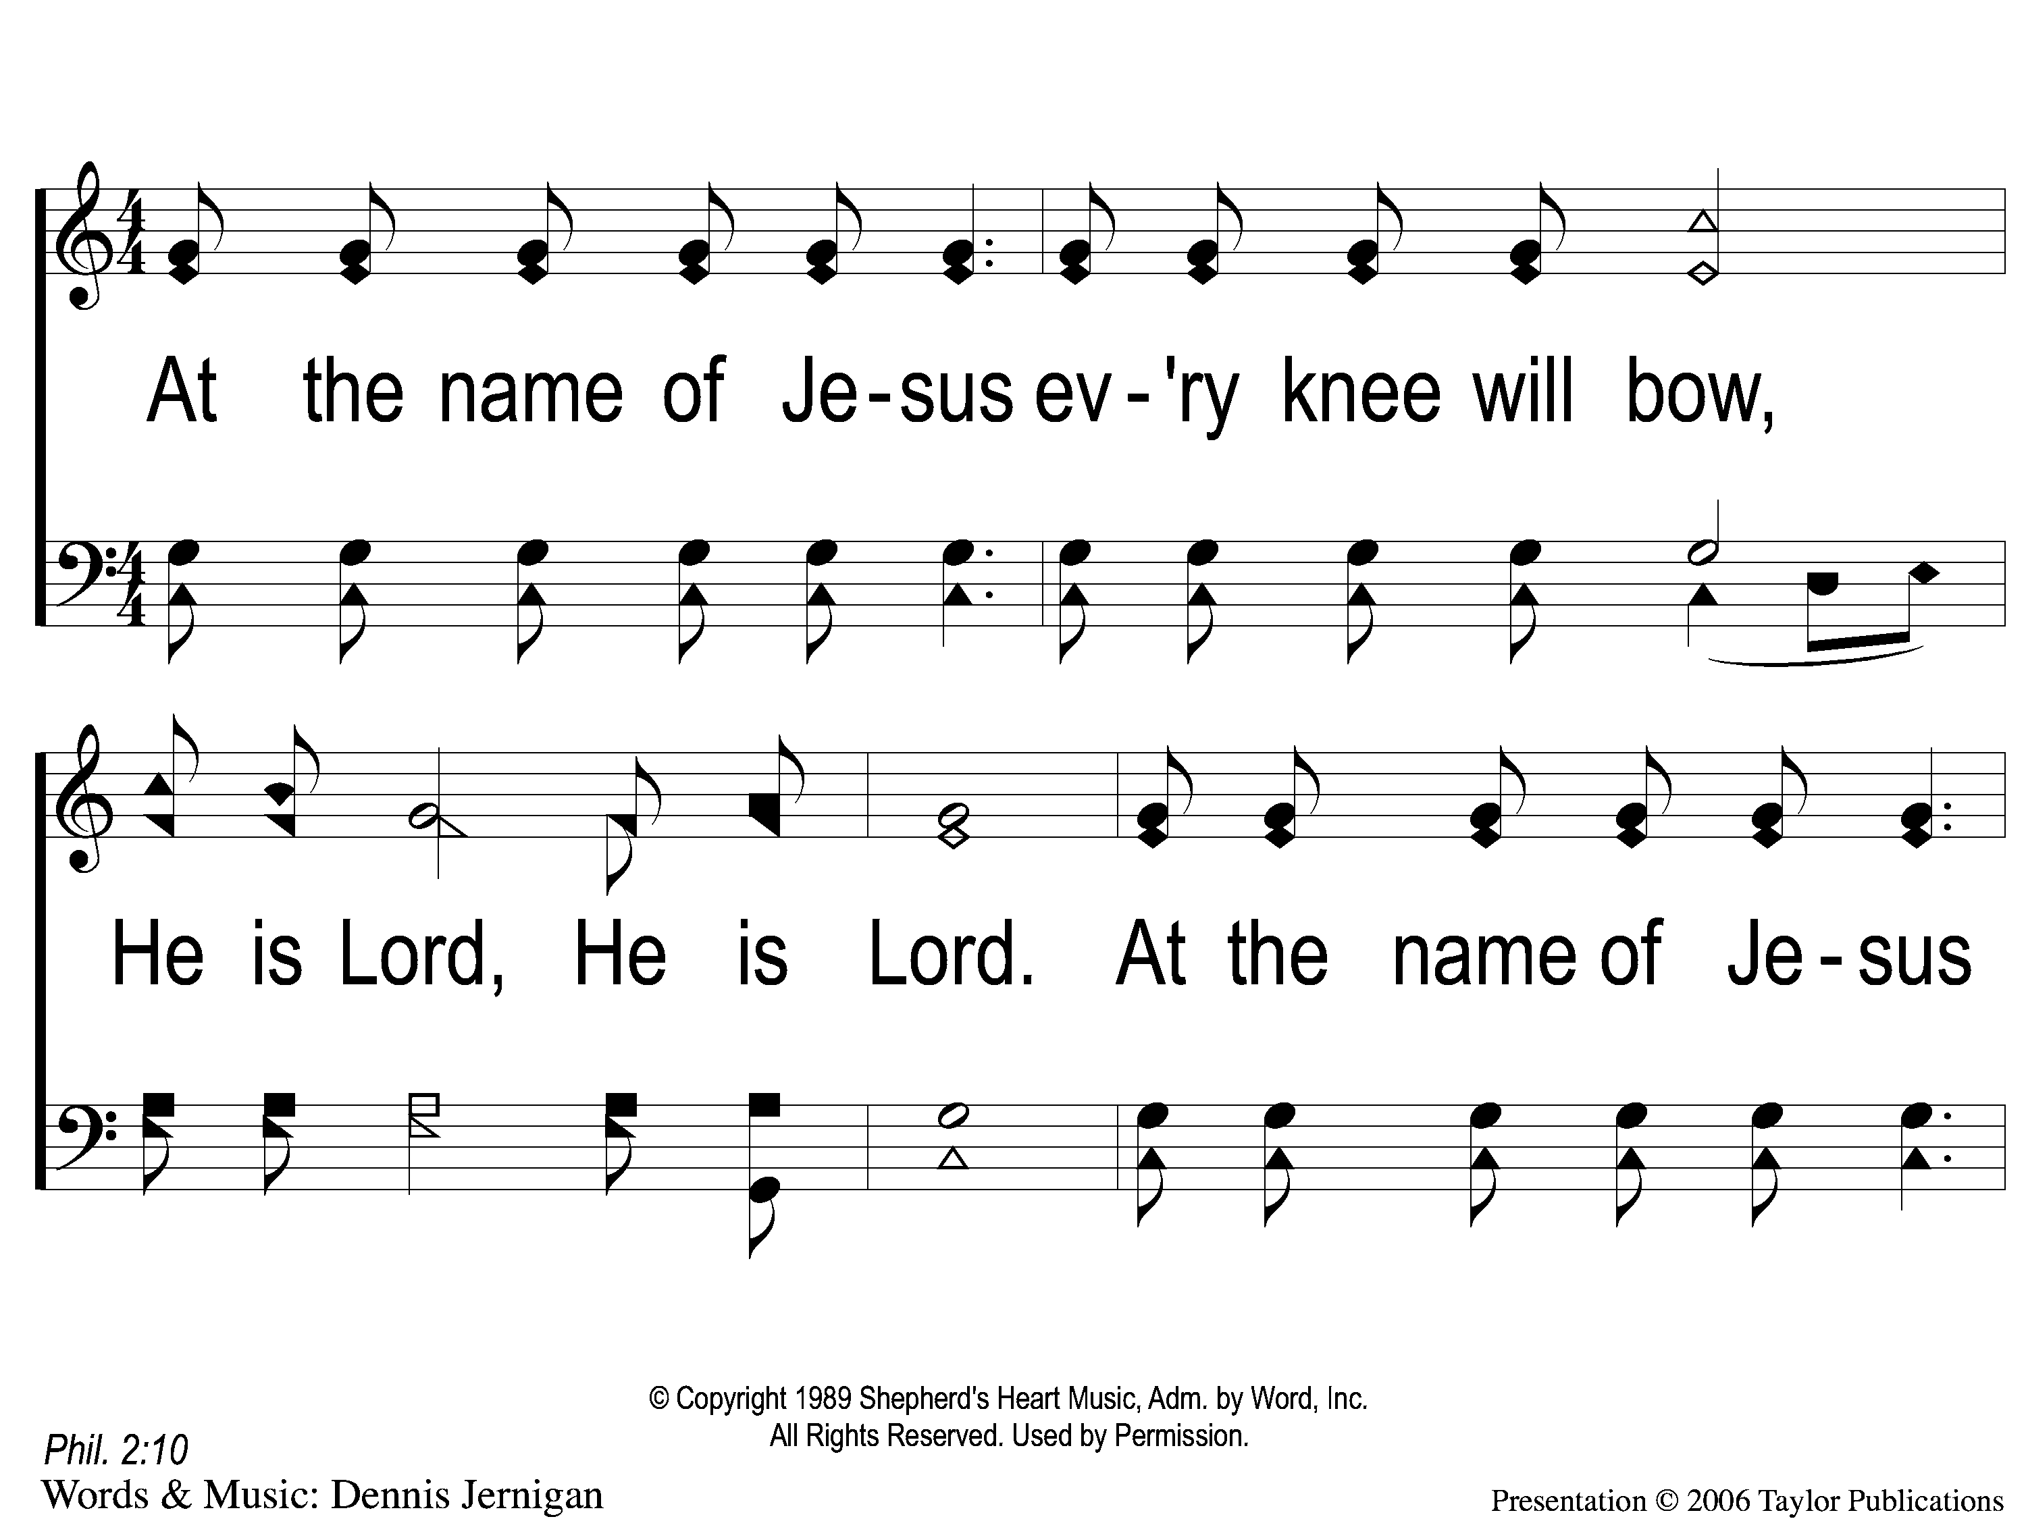
1 At the Name of Jesus
At The Name Of Jesus
310

Slide 2
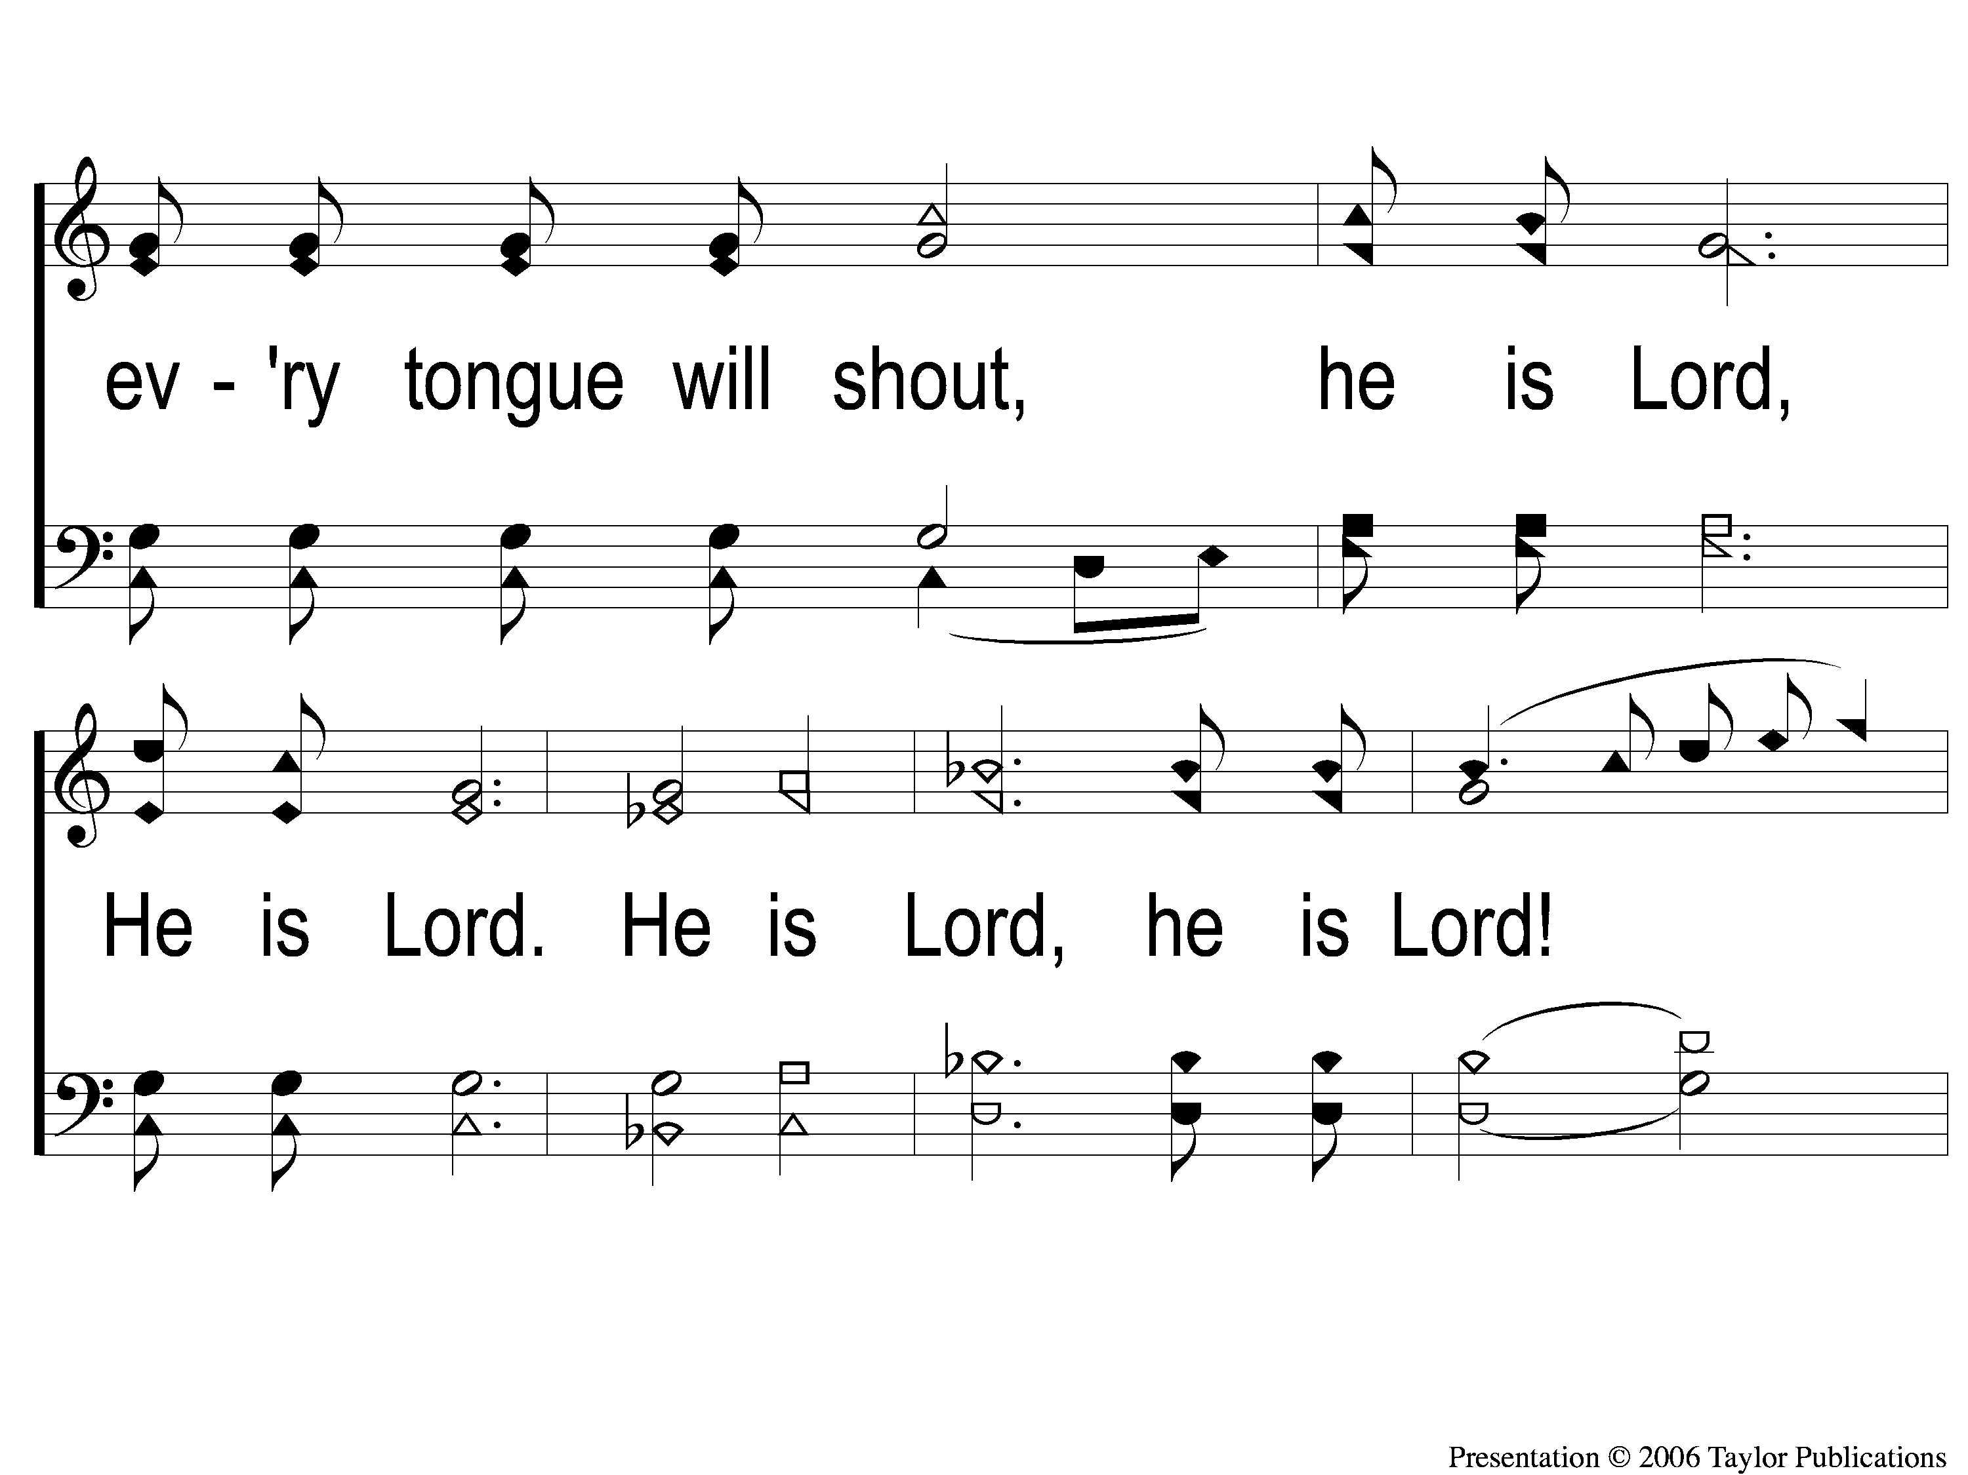
2 At the Name of Jesus
At The Name Of Jesus
310

Slide 3
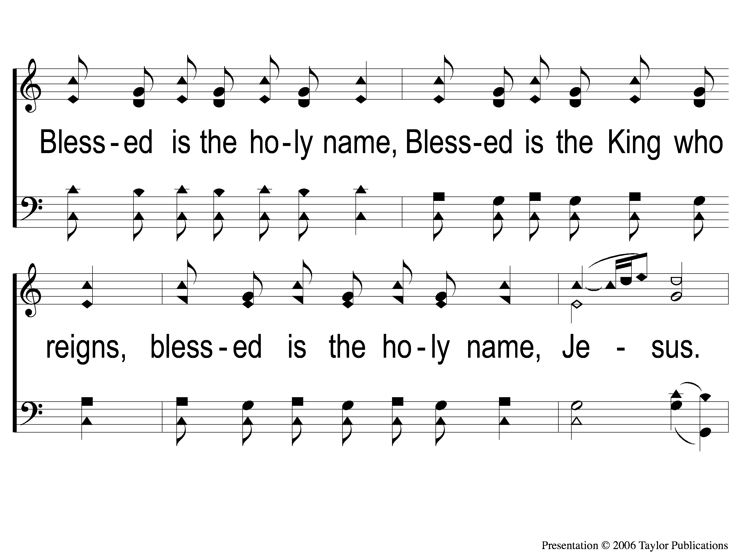
3 At the Name of Jesus
At The Name Of Jesus
310

Slide 4
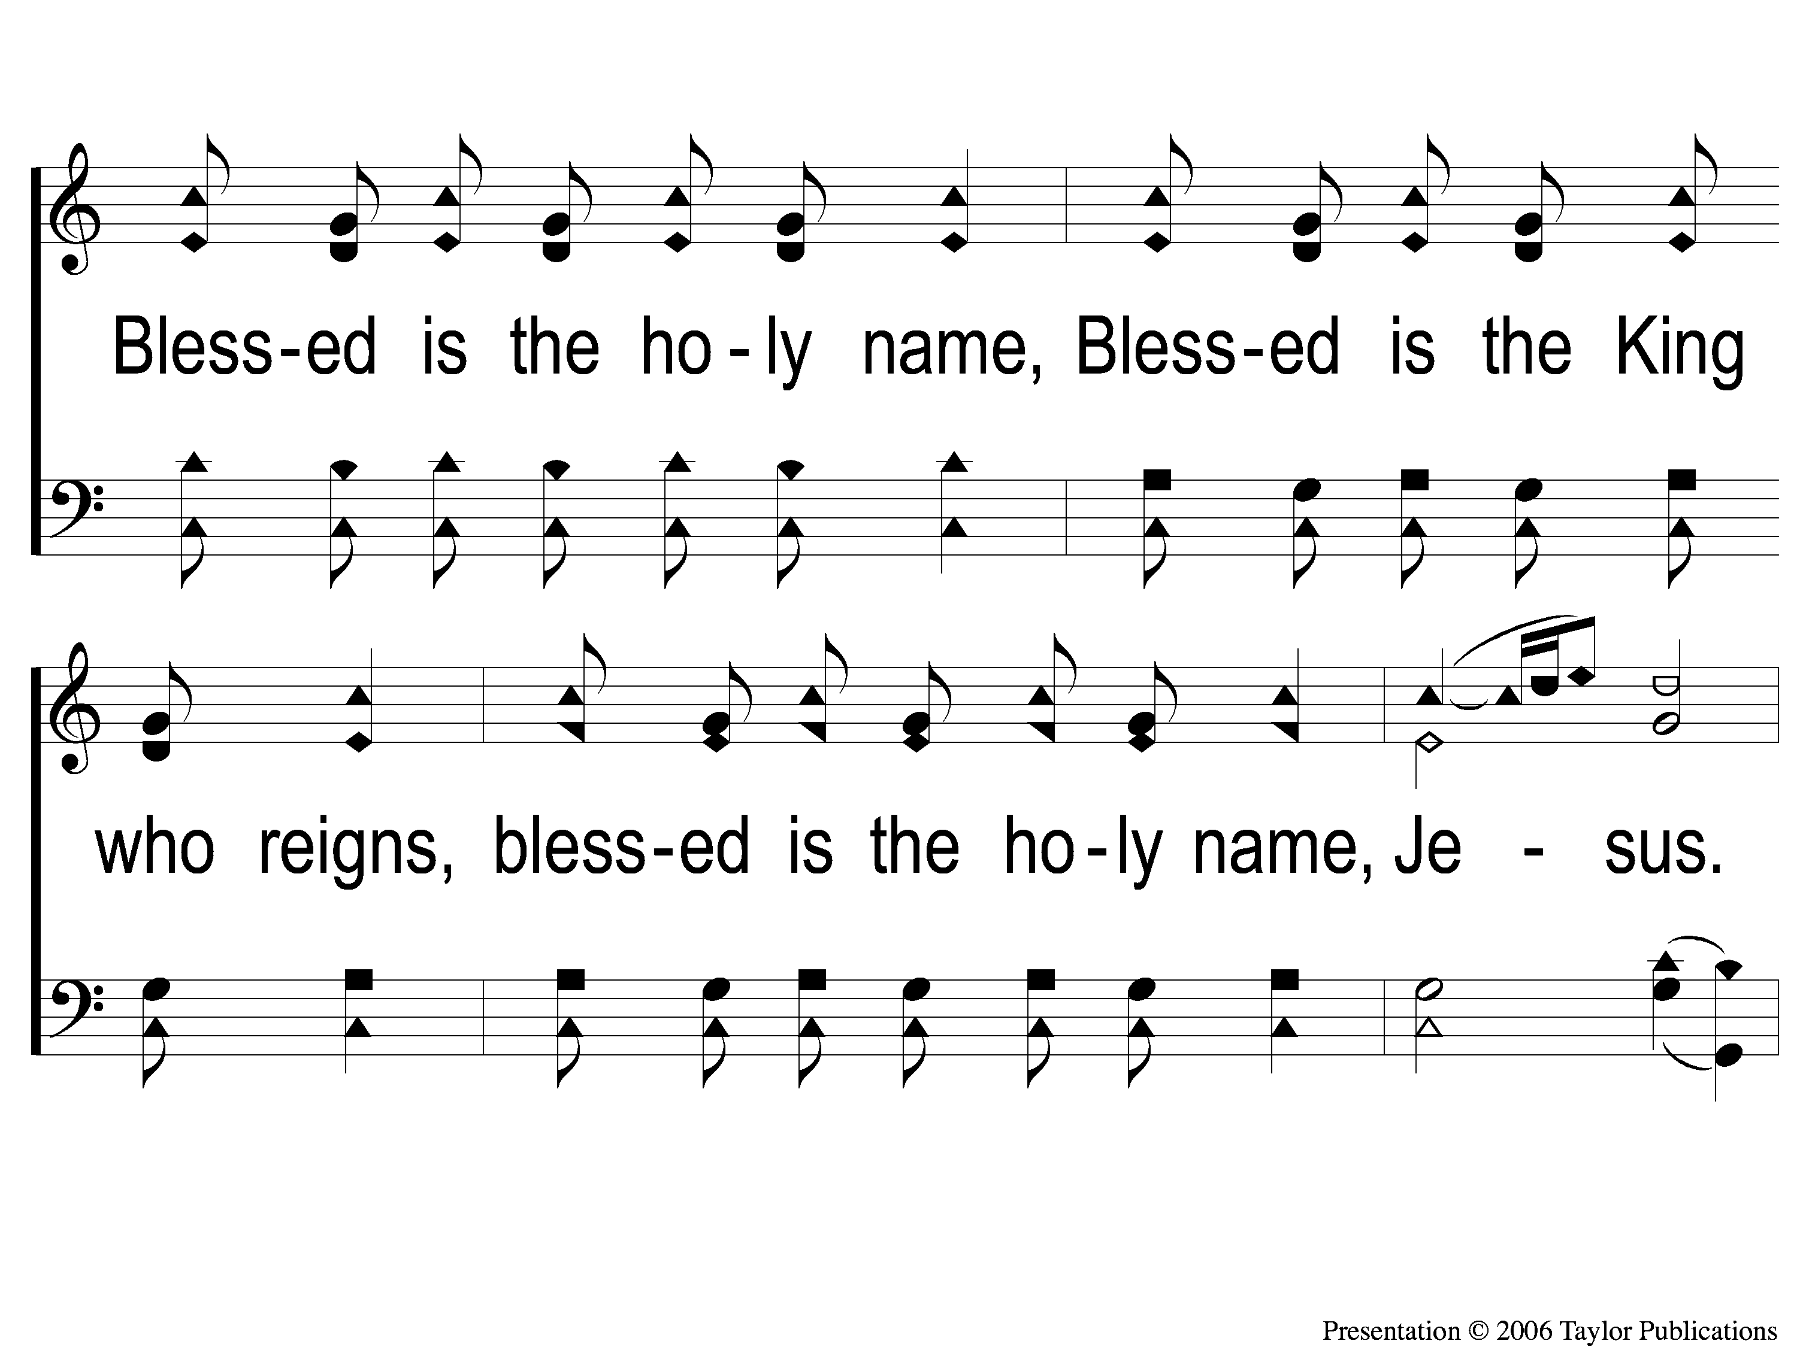
4 At the Name of Jesus
At The Name Of Jesus
310

Slide 5
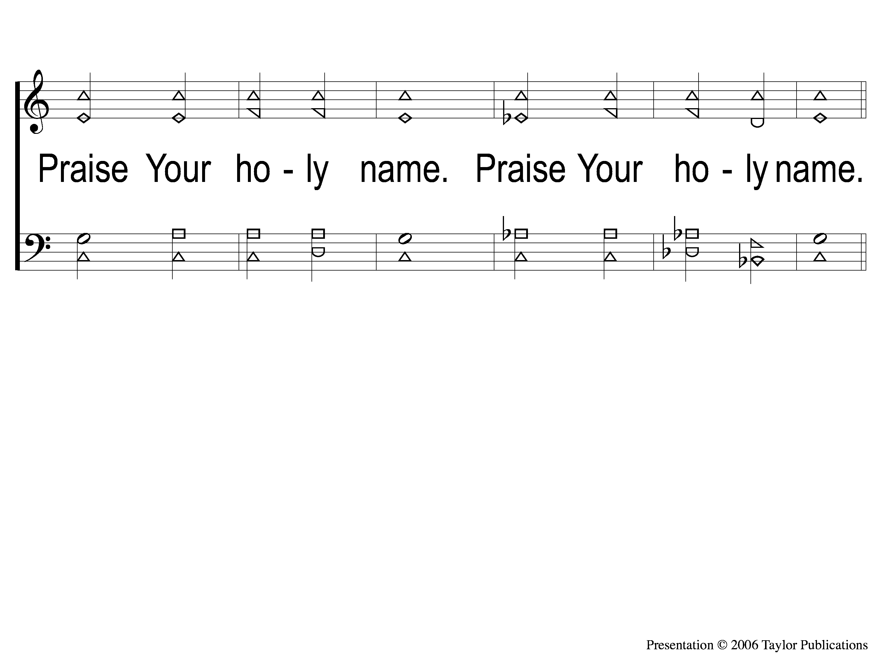
5 At the Name of Jesus
At The Name Of Jesus
310

Slide 6
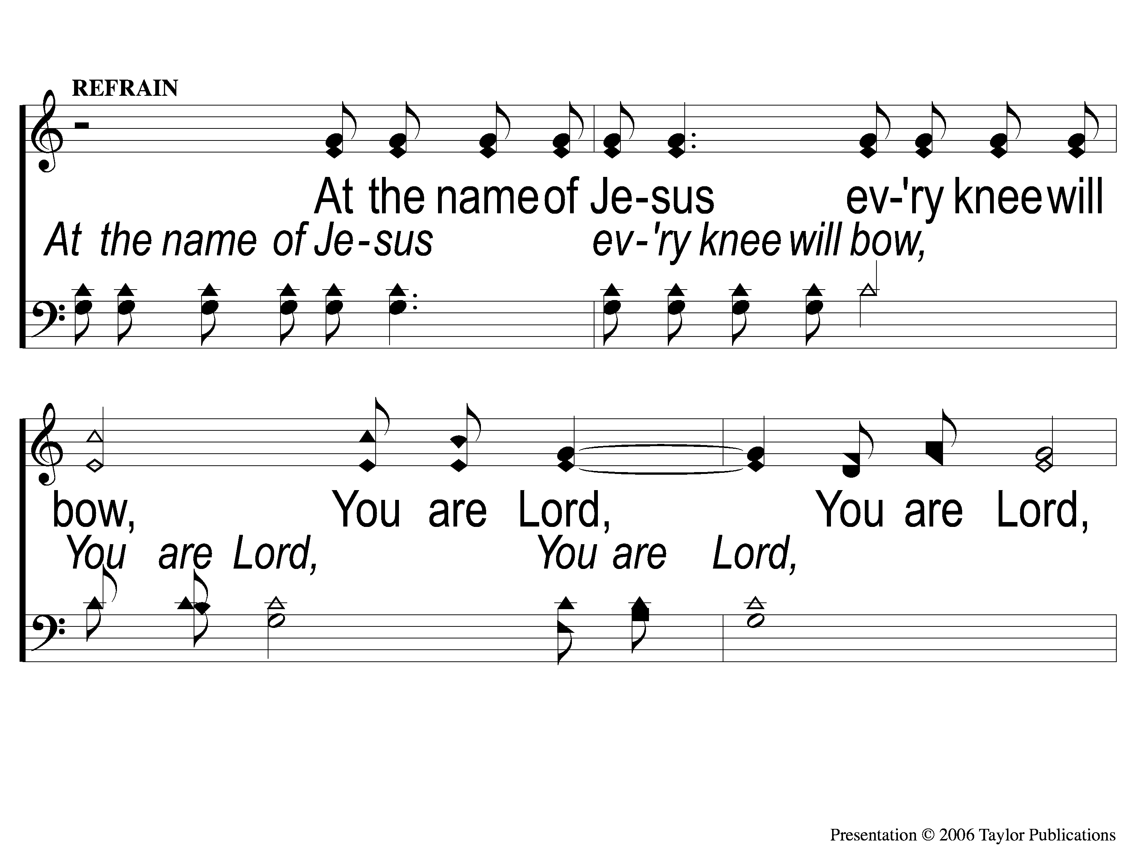
C-1 At the Name of Jesus
At The Name Of Jesus
310

Slide 7
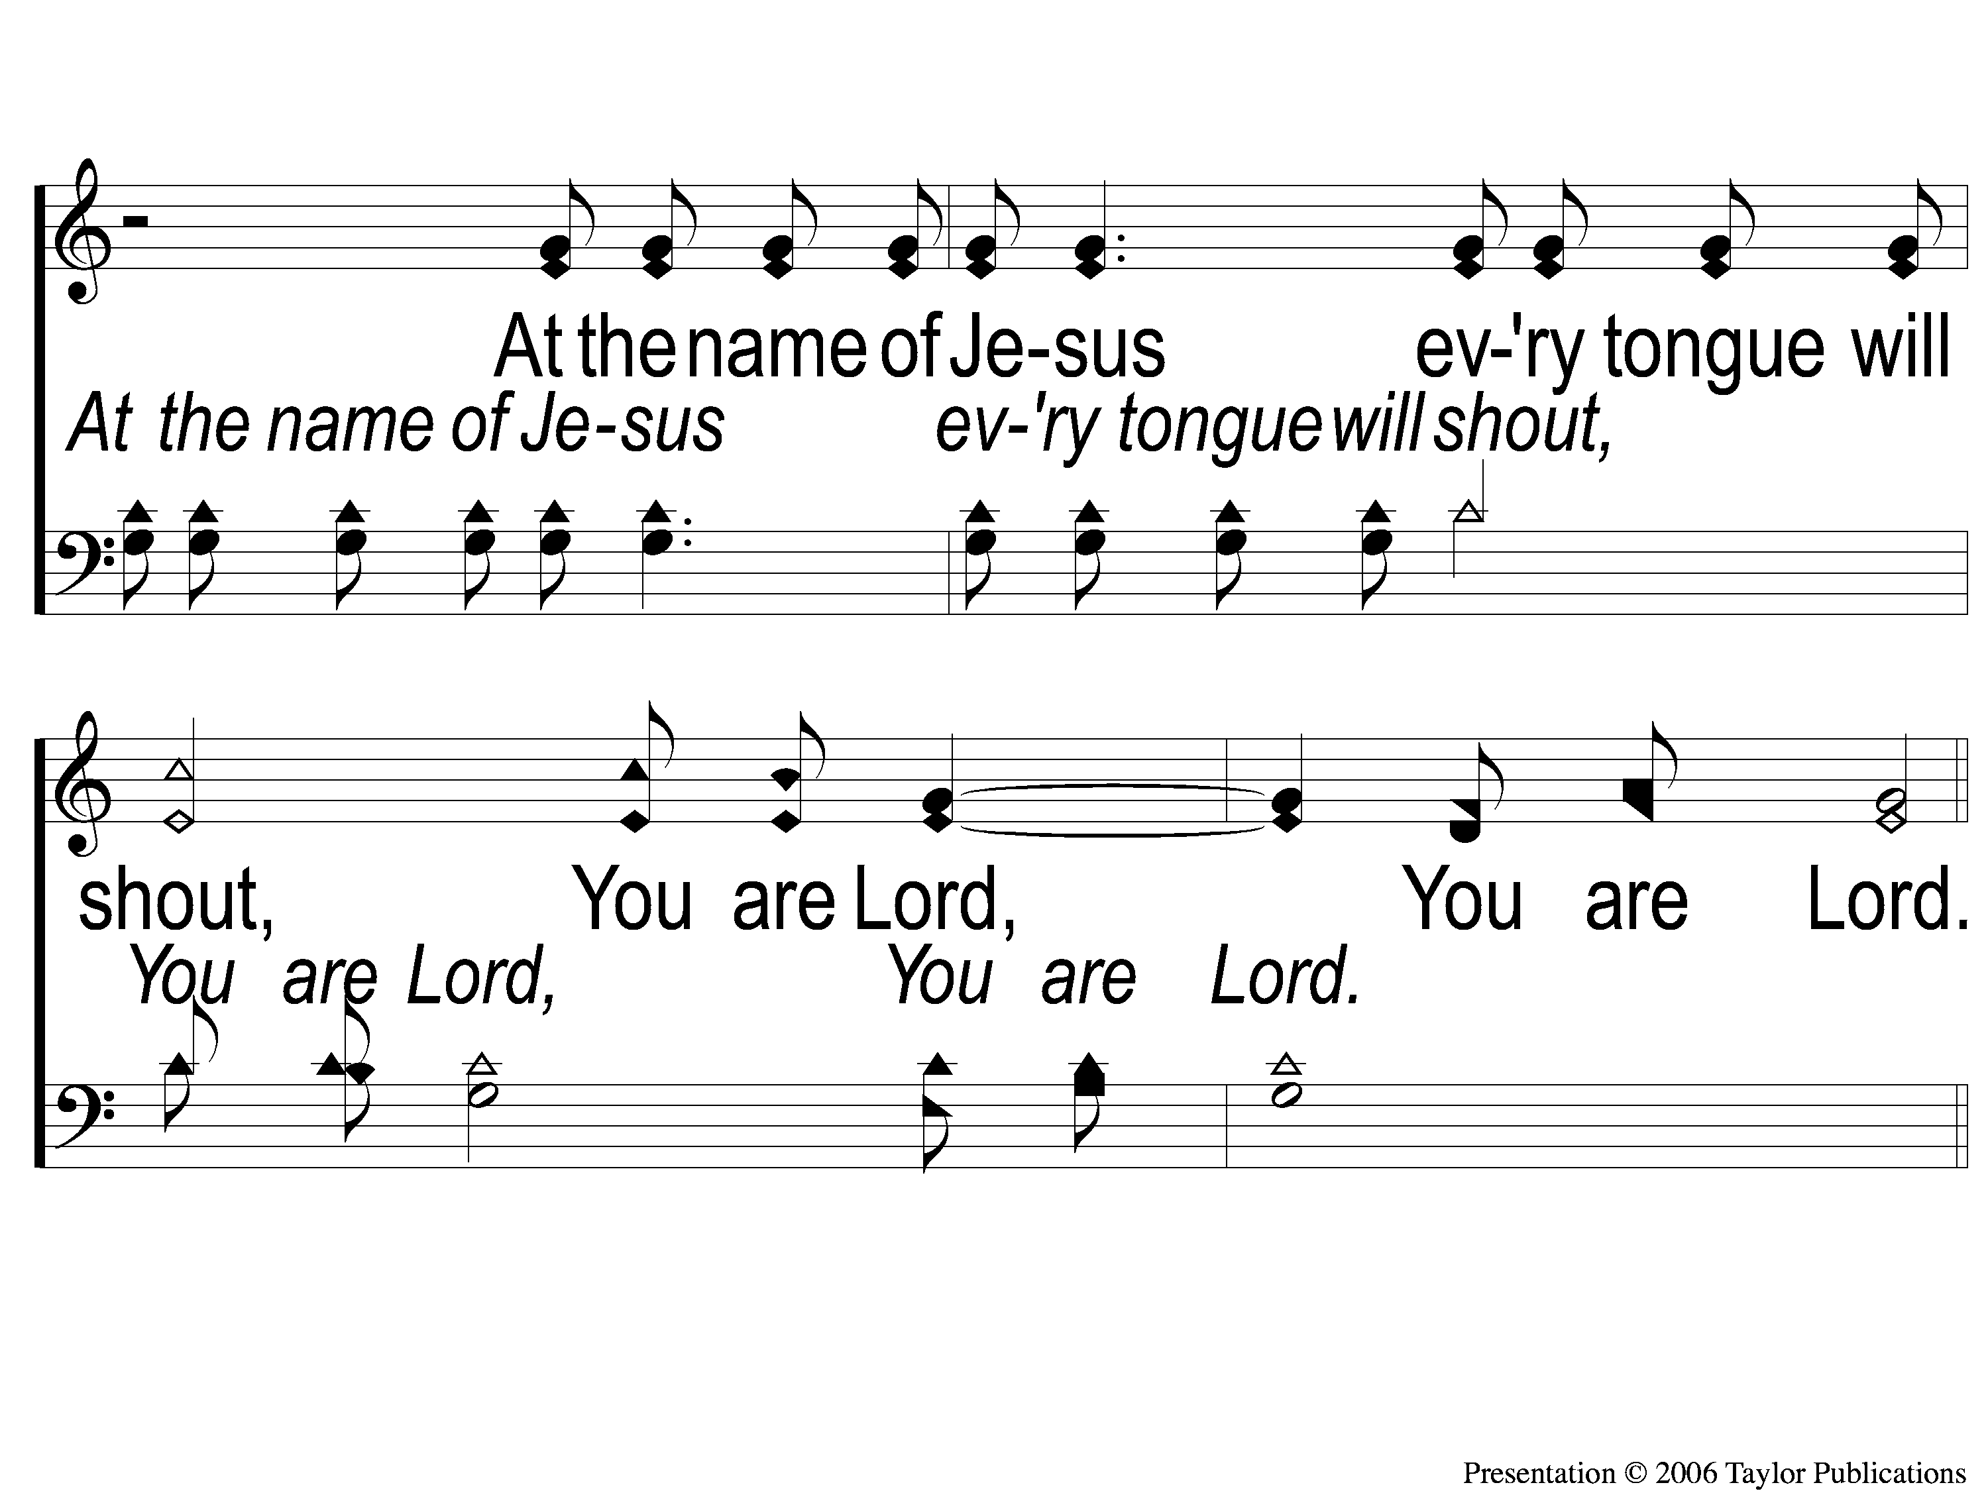
C-2 At the Name of Jesus
At The Name Of Jesus
310

Slide 8
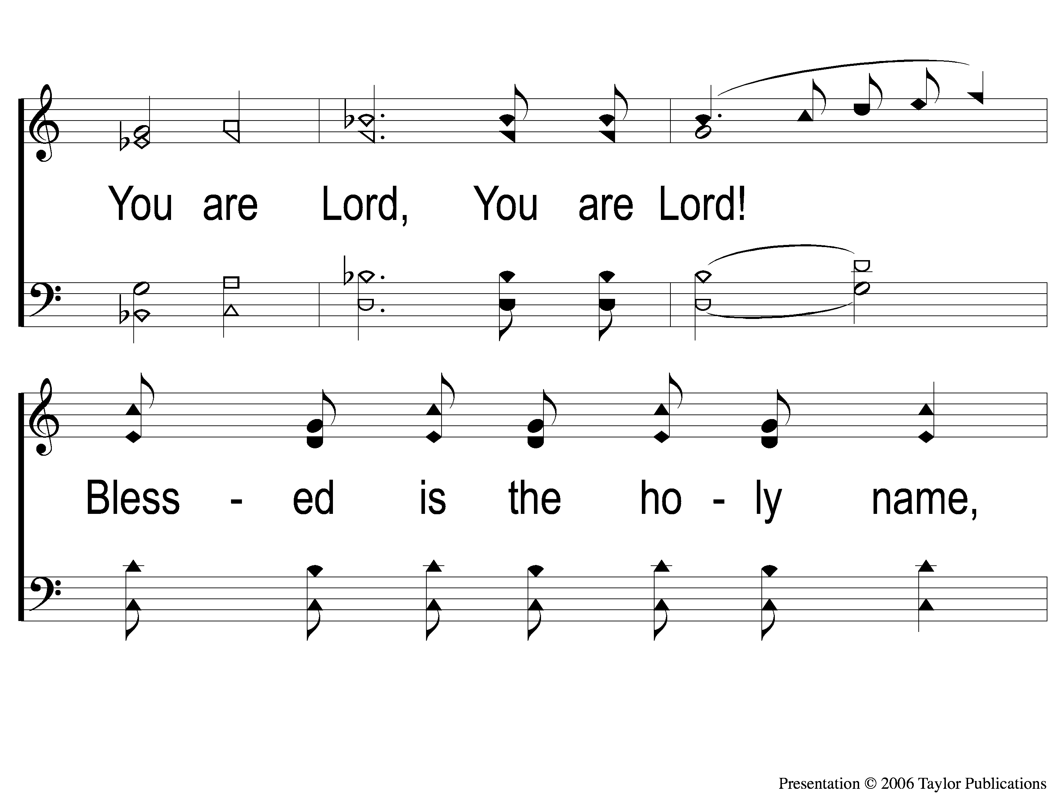
DS-1 At the Name of Jesus
At The Name Of Jesus
310

Slide 9
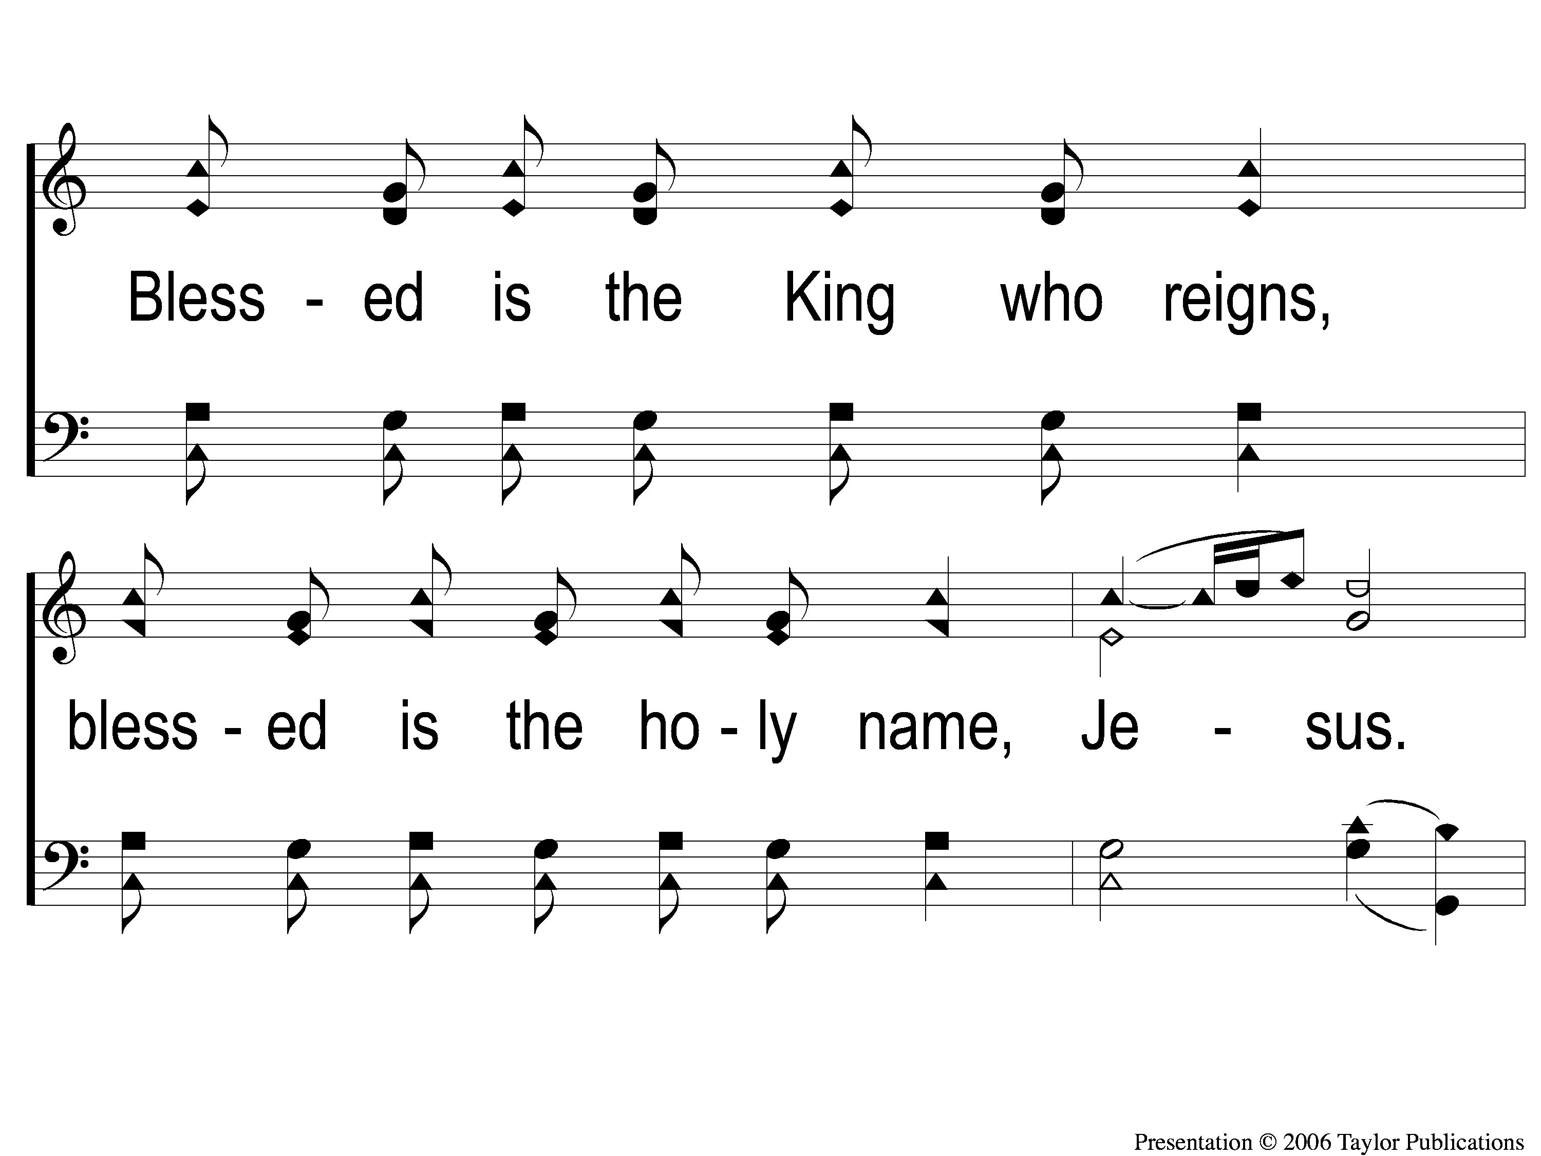
DS-2 At the Name of Jesus
At The Name Of Jesus
310

Slide 10
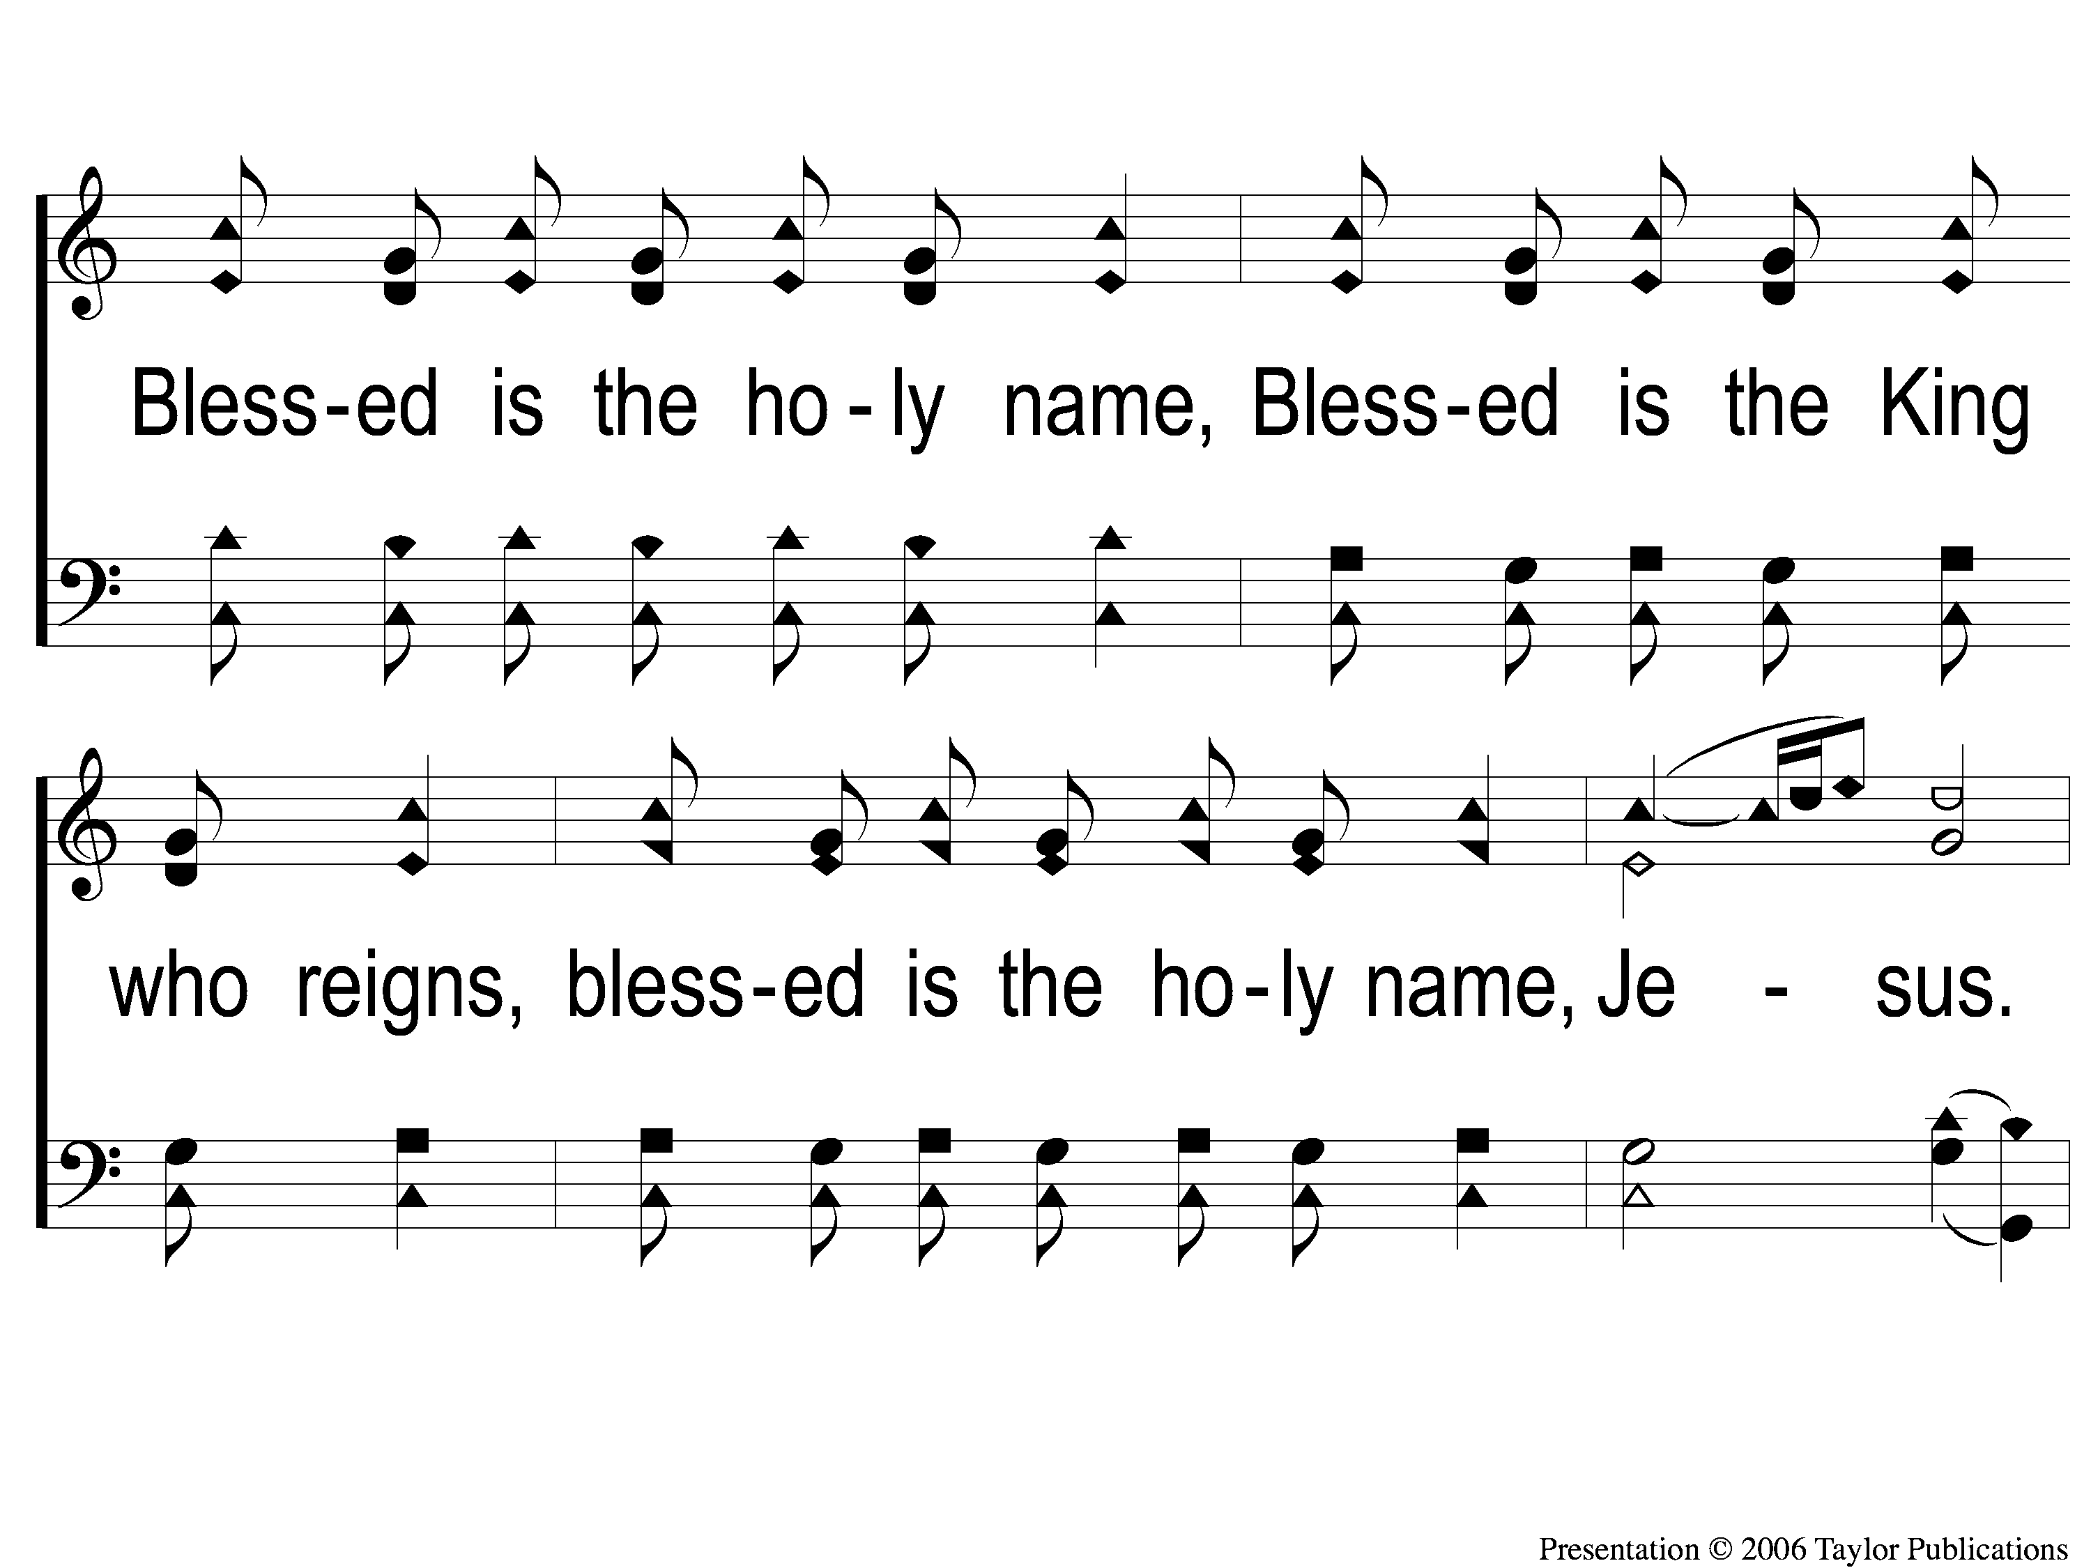
DS-3 At the Name of Jesus
At The Name Of Jesus
310

Slide 11
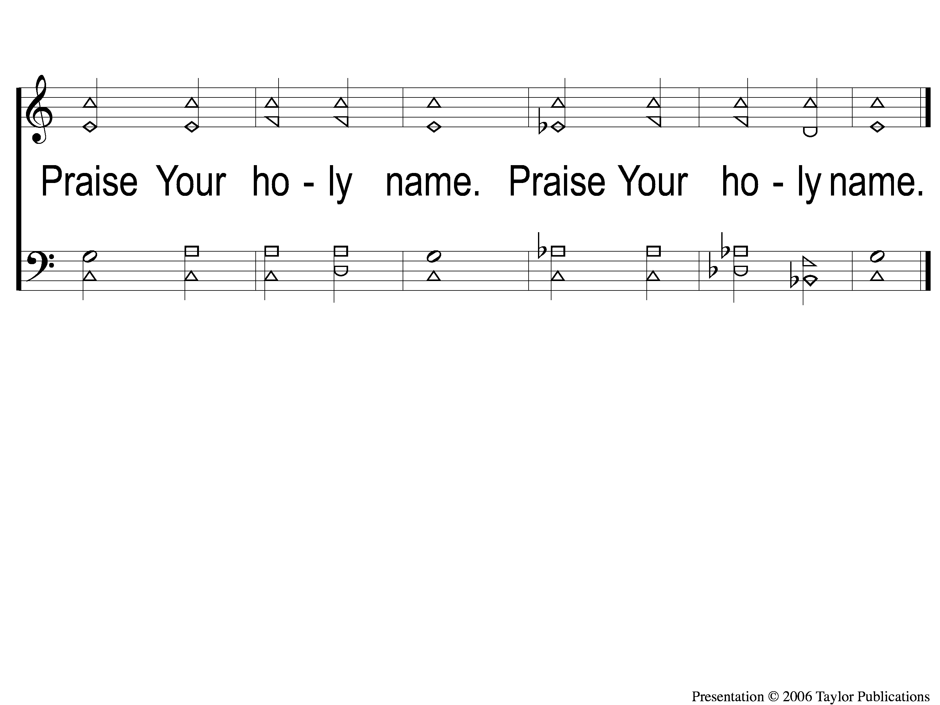
DS-4 At the Name of Jesus
At The Name Of Jesus
310

